Slide 1

Mathematical Modelling and

Slide 2
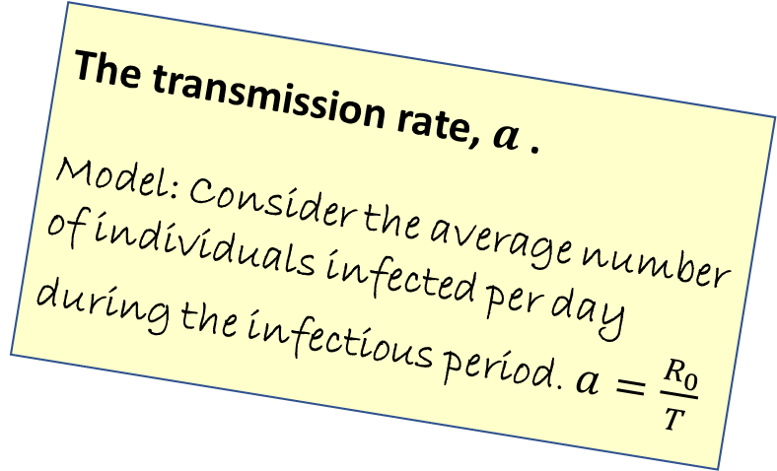
Modelling assumptions
The infectious period.
Model: An individual is infectious for a fixed number of days (T)
In our previous model, the number of infectives increased without limit.
In a refined model, we hope to produce a graph where the number of infectives reaches a peak.
We need to consider further factors.
The transmission rate, $a$ .
Model: Consider the average number of individuals infected per day during the infectious period. $a=\frac{R_{0}}{T}$
Use a compartmental model
Consider how quickly the group of infectives is growing

Slide 3
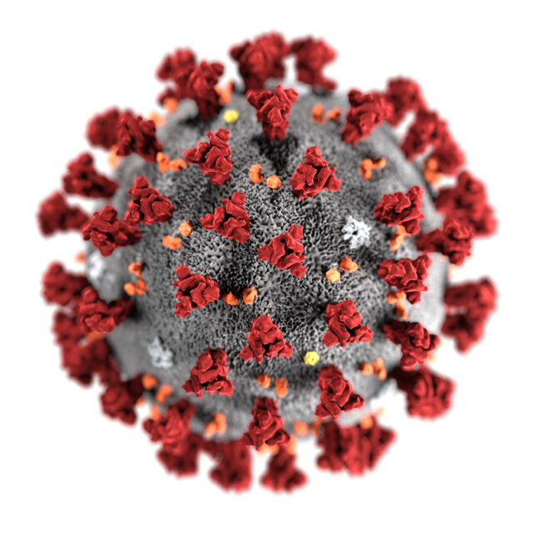


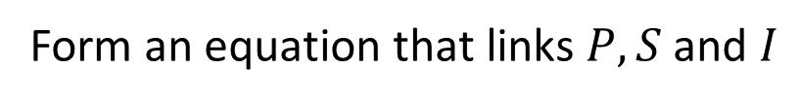


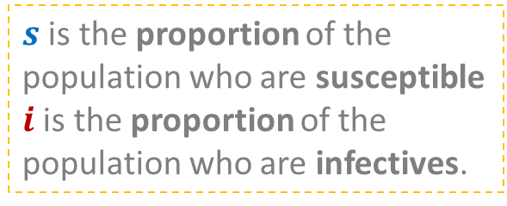

A compartmental model for infectious disease spread
The whole population, $P$, is divided into:
Susceptibles, S
Infectives, I
Form an equation that links $P, S$ and $I$
$$P=S+I$$
$s$ is the proportion of the population who are susceptible
$i$ is the proportion of the population who are infectives.
Or we can form the equation:
$$s+i=1$$

Slide 4


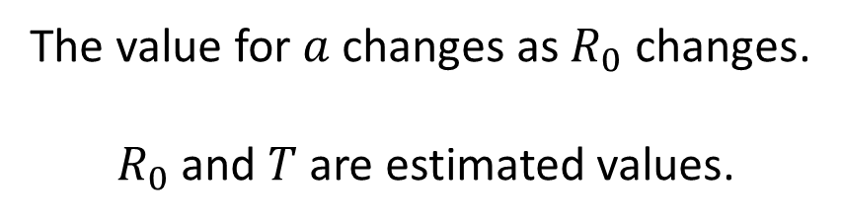
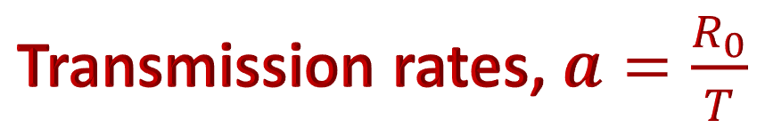




Transmission rates, $a=\frac{R_{0}}{T}$
$$s+i=1$$
The transmission rate will effect the movement from $s$ to $i$ .
$$s$$
$$i$$
The value for $a$ changes as $R_{0}$ changes.
$R_{0}$ and $T$ are estimated values.
COVID-19
$$T=7$$
$$R_{0}=2$$

Slide 5


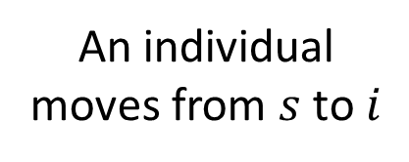
Rates of change
$$s+i=1$$
$$s$$
$$i$$
An individual moves from $s$ to $i$
To understand the spread of this disease, we want to know how fast the group of Infectives is growing.
How can we introduce derivatives?

Slide 6
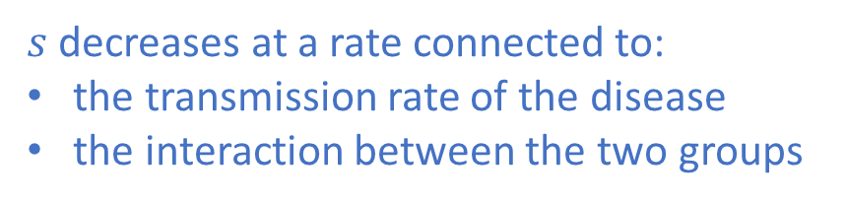
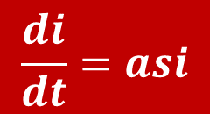
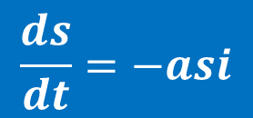
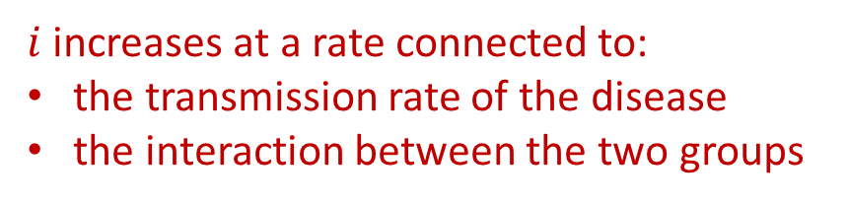
Rates of change
$$s+i=1$$
$$s$$
$$i$$
$s$ decreases at a rate connected to:
the transmission rate of the disease
the interaction between the two groups
$i$ increases at a rate connected to:
the transmission rate of the disease
the interaction between the two groups
$$\frac{ds}{dt}=−asi$$
$$\frac{di}{dt}=asi$$

Slide 7

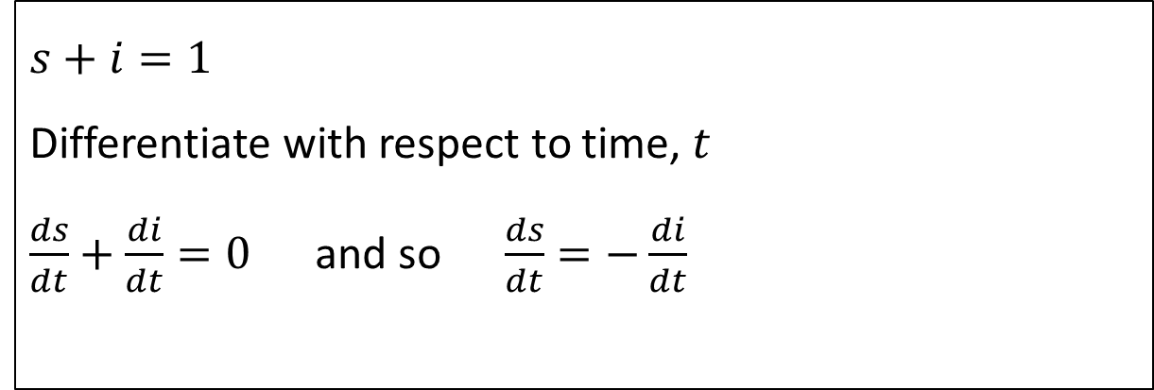
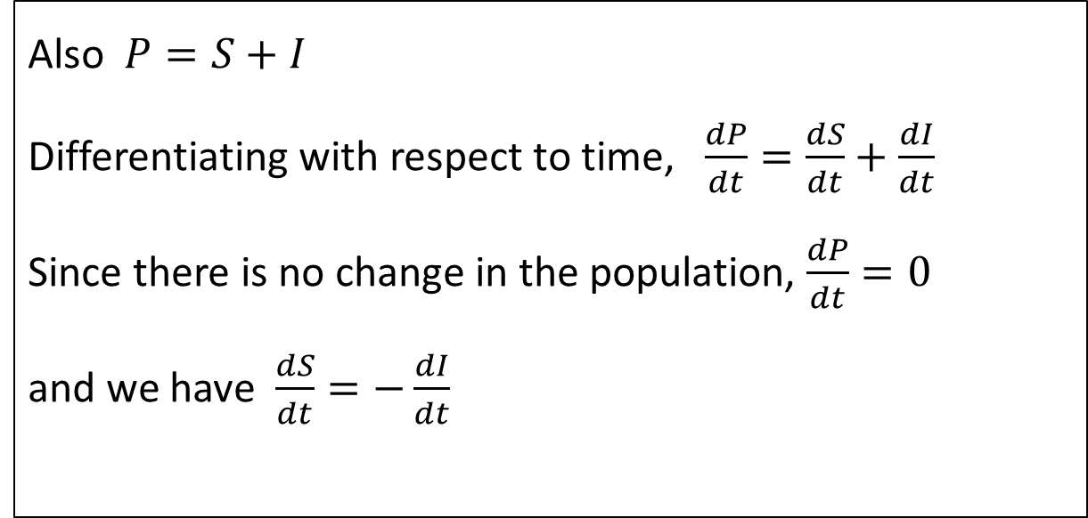
NOTICE
$$s+i=1$$
Differentiate with respect to time, $t$
$\frac{ds}{dt}+\frac{di}{dt}=0$ and so $\frac{ds}{dt}=−\frac{di}{dt}$
Also $P=S+I$
Differentiating with respect to time, $\frac{dP}{dt}=\frac{dS}{dt}+\frac{dI}{dt}$
Since there is no change in the population, $\frac{dP}{dt}=0$
and we have $\frac{dS}{dt}=−\frac{dI}{dt}$

Slide 8






Form a differential equation in $i$ and $t$.
$$s+i=1$$
$$\frac{di}{dt}=asi$$
COVID-19
$$T=7$$
$$\frac{ds}{dt}=−asi$$
$$R_{0}=2$$

Slide 9
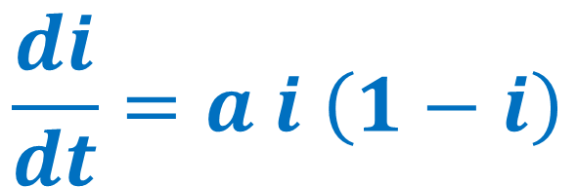
Can you solve the differential equation
$$\frac{di}{dt}=a i \left(1−i\right)$$
and sketch the solution?
We could assume that initially the proportion of the population who are infected is $i_{0}$

Slide 10

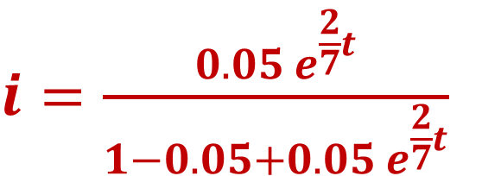
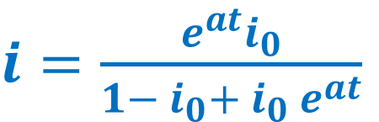
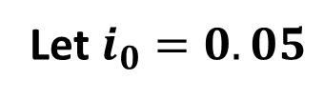


General solution
$i=\frac{e^{at}i_{0}}{1− i_{0}+ i_{0} e^{at}}$
COVID-19
$$T=7$$
$i=\frac{0.05 e^{\frac{2}{7}t}}{1−0.05+0.05 e^{\frac{2}{7}t}}$
$$R_{0}=2$$
$$a=\frac{2}{7}$$
Sketch it
Let $i_{0}=0.05$

Slide 11
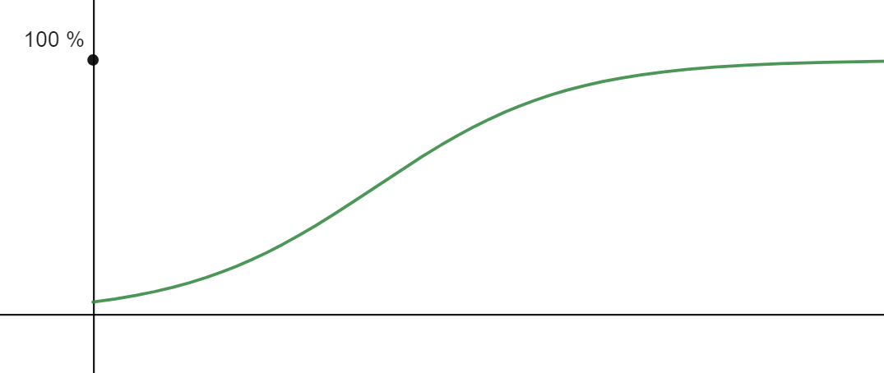
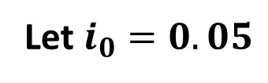

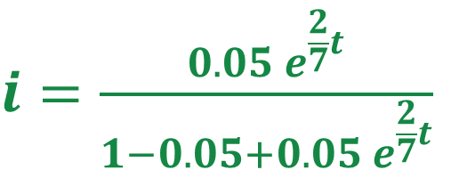

The graph of infectives against time
$i=\frac{0.05 e^{\frac{2}{7}t}}{1−0.05+0.05 e^{\frac{2}{7}t}}$
How can you alter shape of the graph?
COVID-19
infectives
$$T=7$$
$$R_{0}=2$$
$$a=\frac{2}{7}$$
Let $i_{0}=0.05$
time
What does this mean in our context?

Slide 12
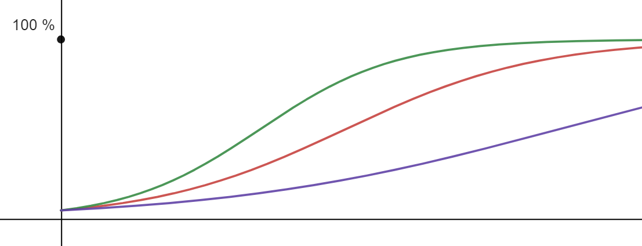



Different values of $R_{0}$ alter the curve
infectives
$$R_{0}=2$$
$$R_{0}=1.4$$
$$R_{0}=0.8$$
time
This model shows that eventually the whole population will become infected – the curve flattens.
If we want to delay the whole population becoming infected, we need to change the $R$ value.

Slide 13
Modelling assumptions
The compartmental model introduces a maximum value for the number of infectives.
However, the number of infectives does not reduce.
What further refinements could we make?
An individual can leave the group of invectives.
The recovery rate can be considered.
Use a different compartmental model
Consider how fast the group of infectives is growing

Slide 14


Independent tasks

Slide 15
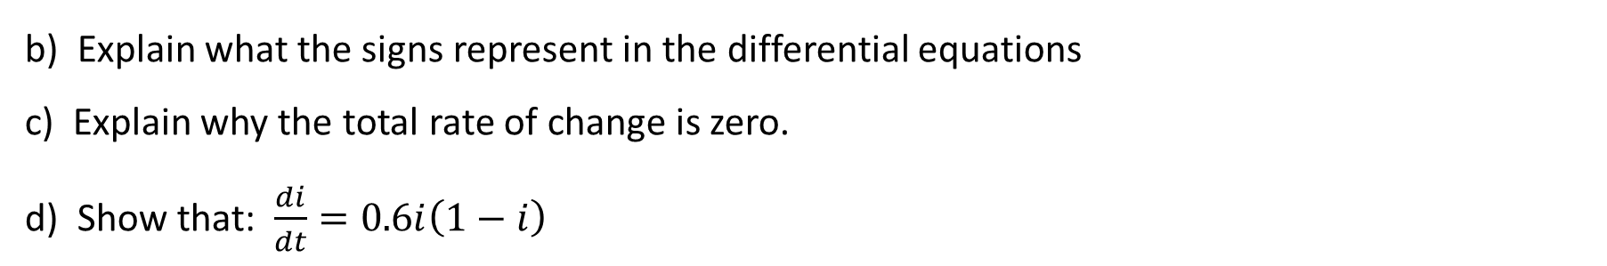
The $s−i$ compartmental model
a) Explain why $s+i=1$
In a particular outbreak, the transmission rate,$a$, is taken to be $0.6$.
Hence the rate of change of the two groups is given by: $\frac{ds}{dt}=−0.6si$ and $\frac{di}{dt}=0.6si$
b) Explain what the signs represent in the differential equations
c) Explain why the total rate of change is zero.
d) Show that: $\frac{di}{dt}=0.6i\left(1−i\right)$
Initially 5% of the population are thought to be infected with the disease.
Solve the differential equation to find $i$ in terms of $t$.
Use a graph-plotter to sketch the shape of $i$ against $t$, $t≥0$.
Use the graph to describe how the infected population changes over time.

Slide 16
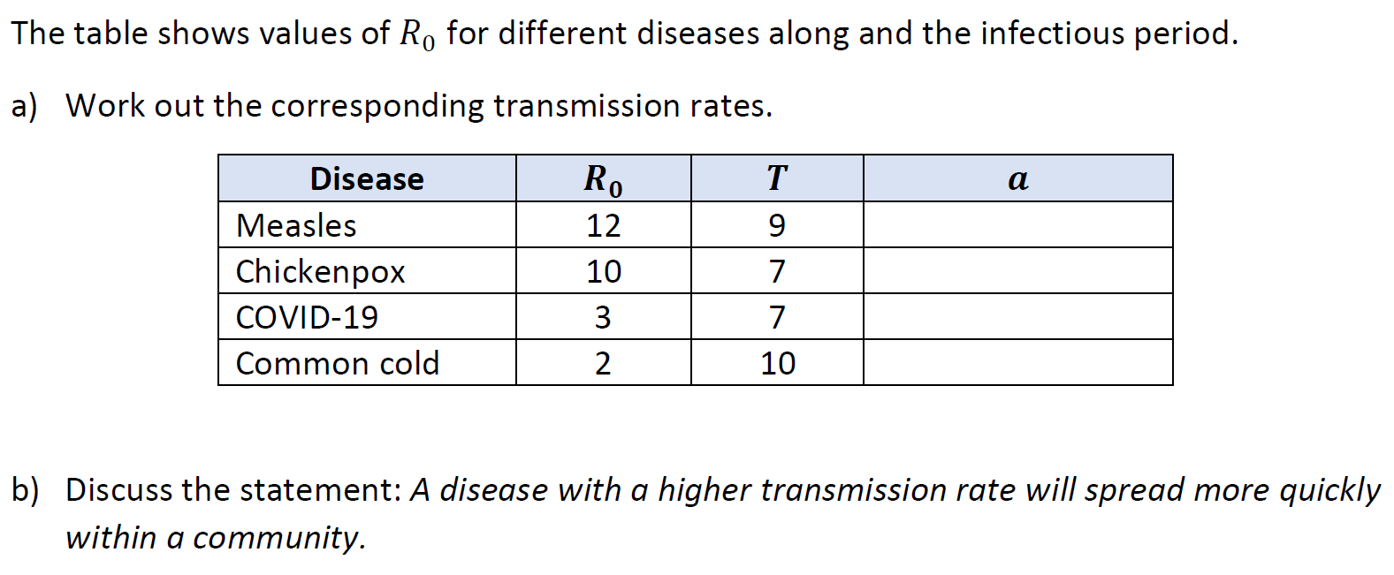
Discuss: transmission rates

Slide 17

Ideas to explore further

Slide 18


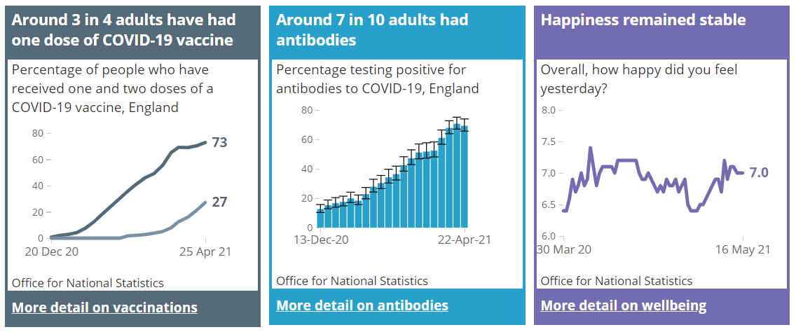
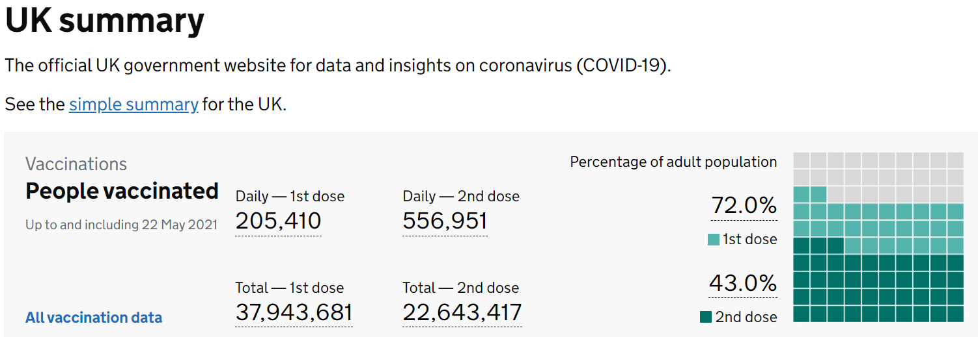
Look at how national statistics are collected and interpreted

Slide 19
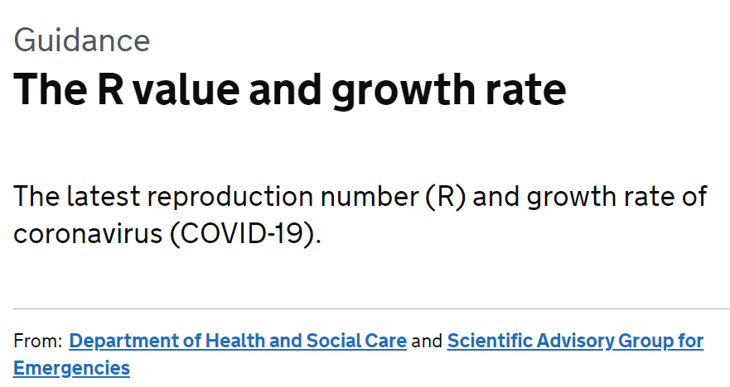



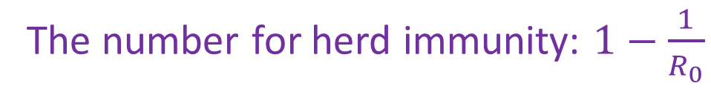
R values, herd immunity and Dr Hannah Fry
In Dec 2019, Dr Hannah Fry explained herd immunity in the Christmas Lectures [22mins]
The number for herd immunity: $1−\frac{1}{R_{0}}$

